Slide 1

MEAT
Is there a link between meat consumption and the global increase in obesity?
Nashville Software School
Part Time Data Analytics Cohort 7
Capstone Project by Steven Goolsby
Python
Plotly Chart Studio
Power BI
PowerPoint

Slide 2
Motivation
Coming from a traditional southern family I was raised with the idea that you had to have a meat as the centerpiece of the meal.
I have always had trouble controlling weight.
Recently, independent studies show there could be a link between the increase in meat consumption and the increase in obesity.
Over the past year, I have been able to lose and keep off close to 60 pounds by cutting +/- 90% of meat out of my diet and increasing activity.

Slide 3
What is “Obesity”?
Healthy Weight Range = BMI between 18.5 - 24.9
Underweight = BMI < 18.5
Obese Range = BMI >30
Worldwide obesity has nearly tripled since 1975
* Information provided by: World Health Org. , Centers for Disease Control and Prevention.
Notes:
I would like to say before we get too deep that this data is ONLY looking at the possible link between meat consumption and rates of obesity. There are obviously many underlying and lifestyle conditions that could affect these findings.

Slide 4
United States Data
* Data provided by: NCDRisC.org and Ourworldindata.org
Notes:
First, we’ll look at the data that comes from ncdrisc.ord and Ourworldindata.org that specifically covers the United States.

Slide 5
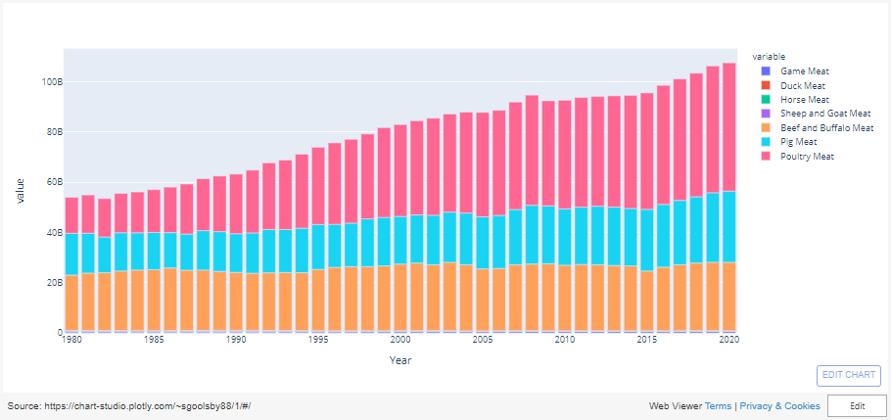
United States Meat Production (pounds) by Year
Notes:
In our first graph we see the total meat production for the United States by year. These totals are in pounds.

Slide 6
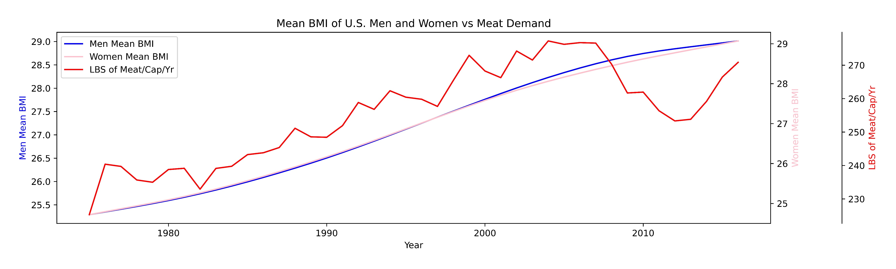

Slide 7
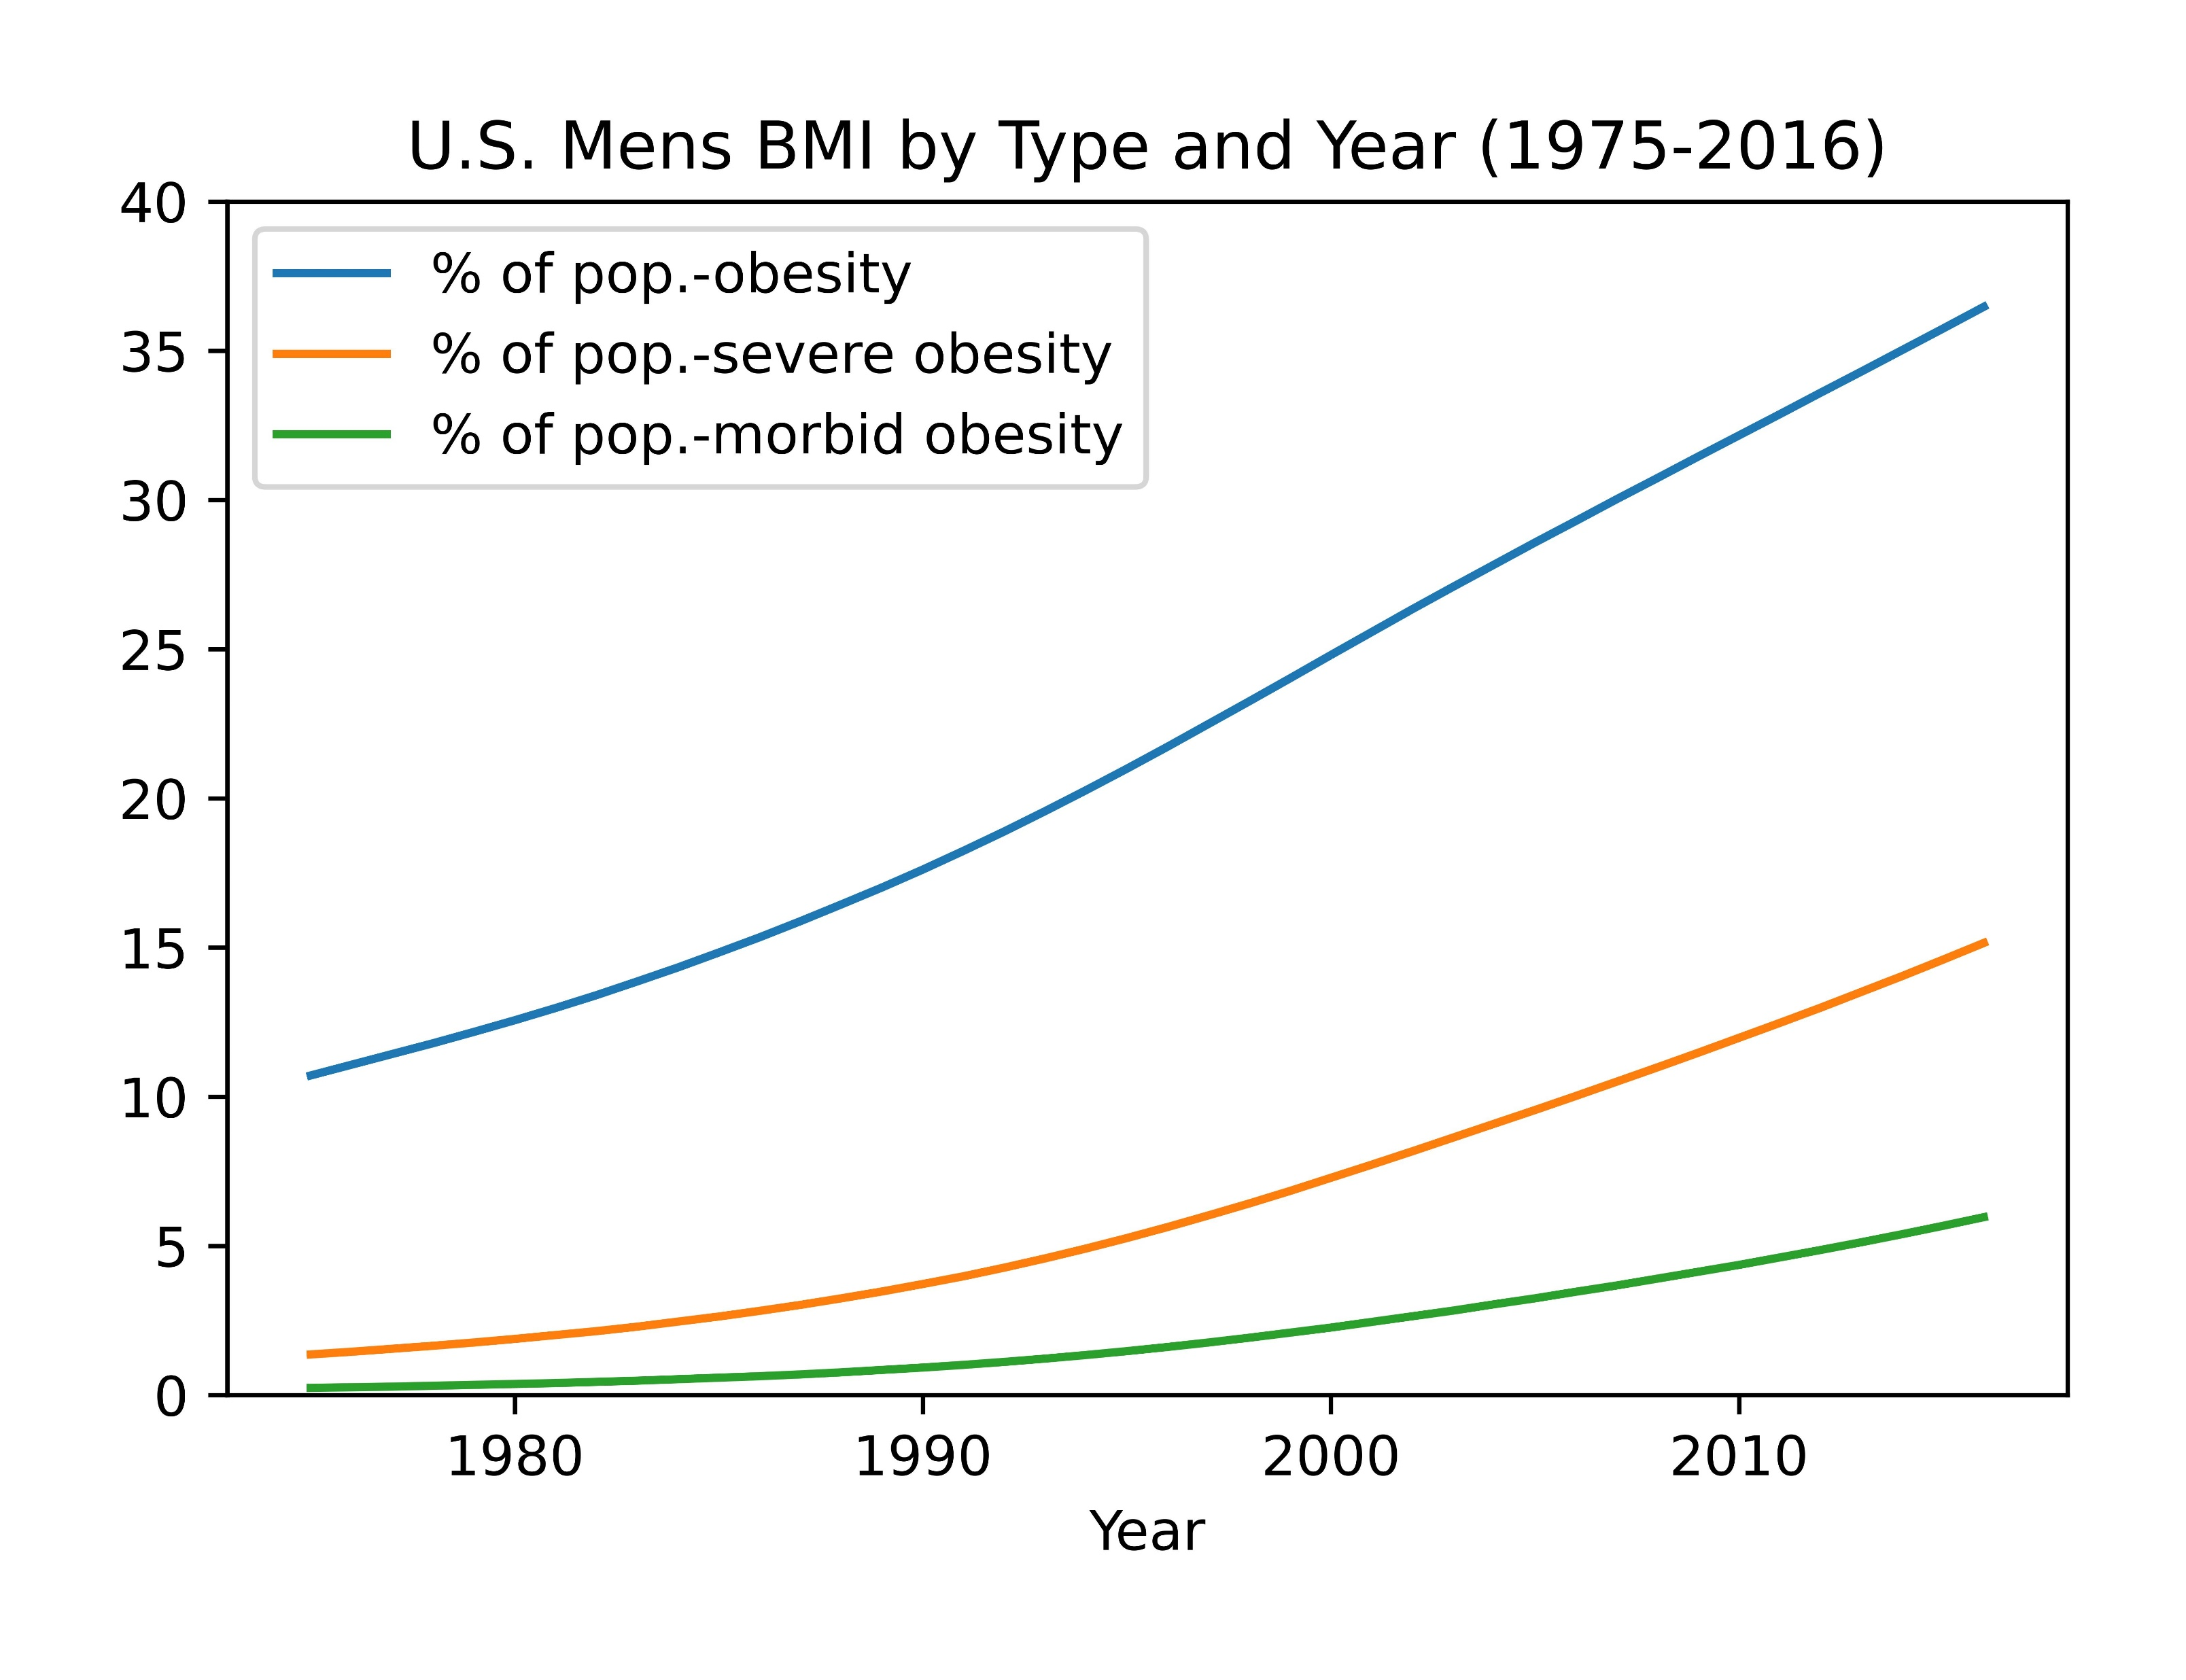
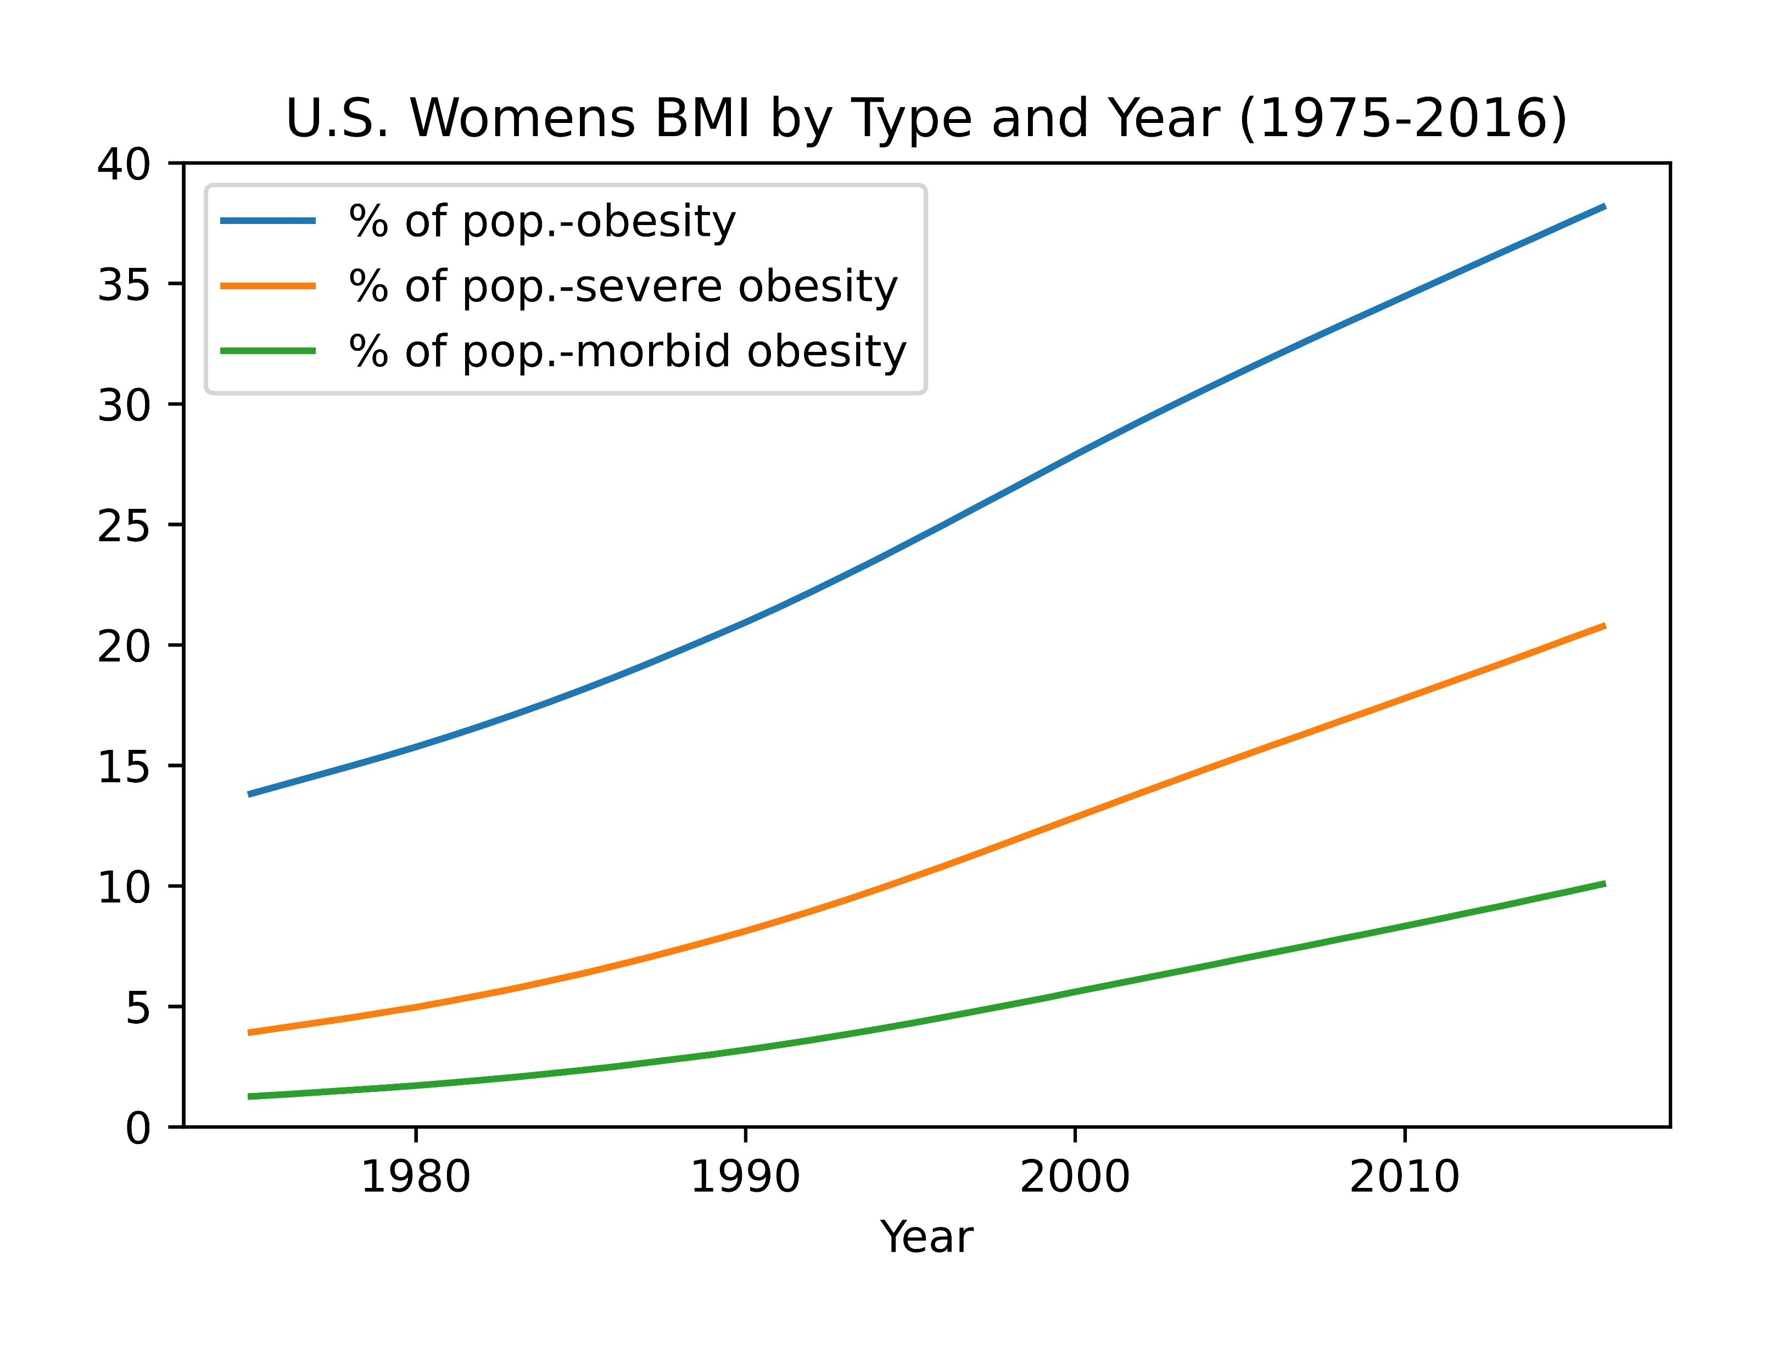
Notes:
Here we see the population percentage of each class of obesity by year for both men and women. Again, you can see that both men and women trend upward at almost the same rate, although there appears to be a higher percentage rate in women over men.

Slide 8
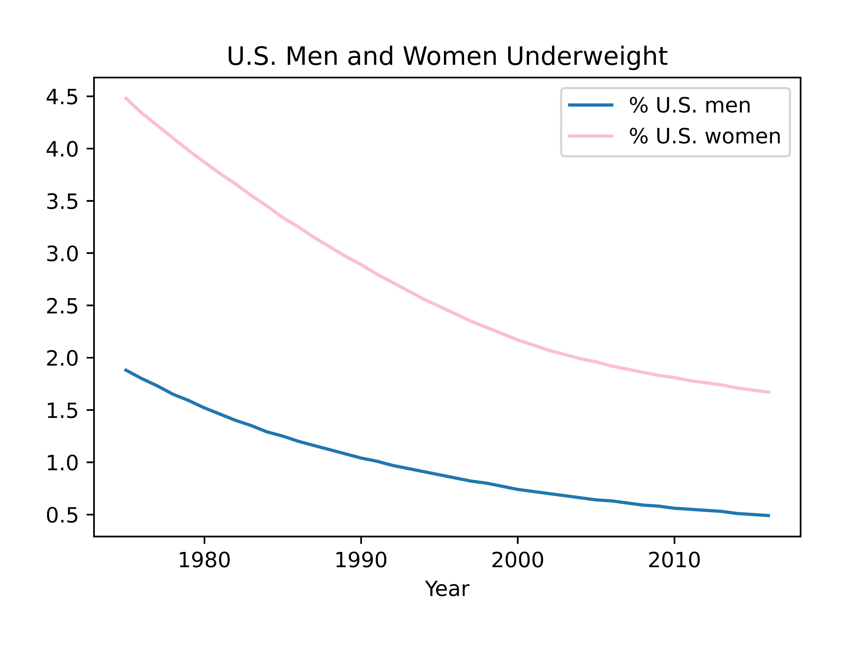
Notes:
Here we see the population percentage of underweight individuals. This helps to confirm the previous findings as you can see the rate of underweight individuals had a steady decline over the same time frame.

Slide 9

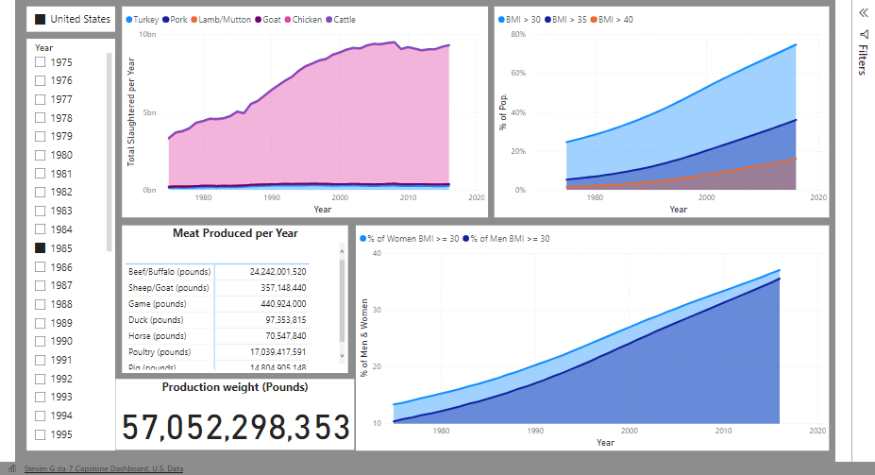
Notes:
And here we have an interactive dashboard that just helps to show the same findings in a different light. The Meat production and production weight are both in pounds per year.
The Total slaughtered animals graph shows the amount of individual animals per year.

Slide 10
Worldwide Data
* Data provided by: NCDRisC.org and Ourworldindata.org
Notes:
And we can’t forget about the rest of the world. This data also comes from ncdrisc.org and Ourworldindata.org.

Slide 11
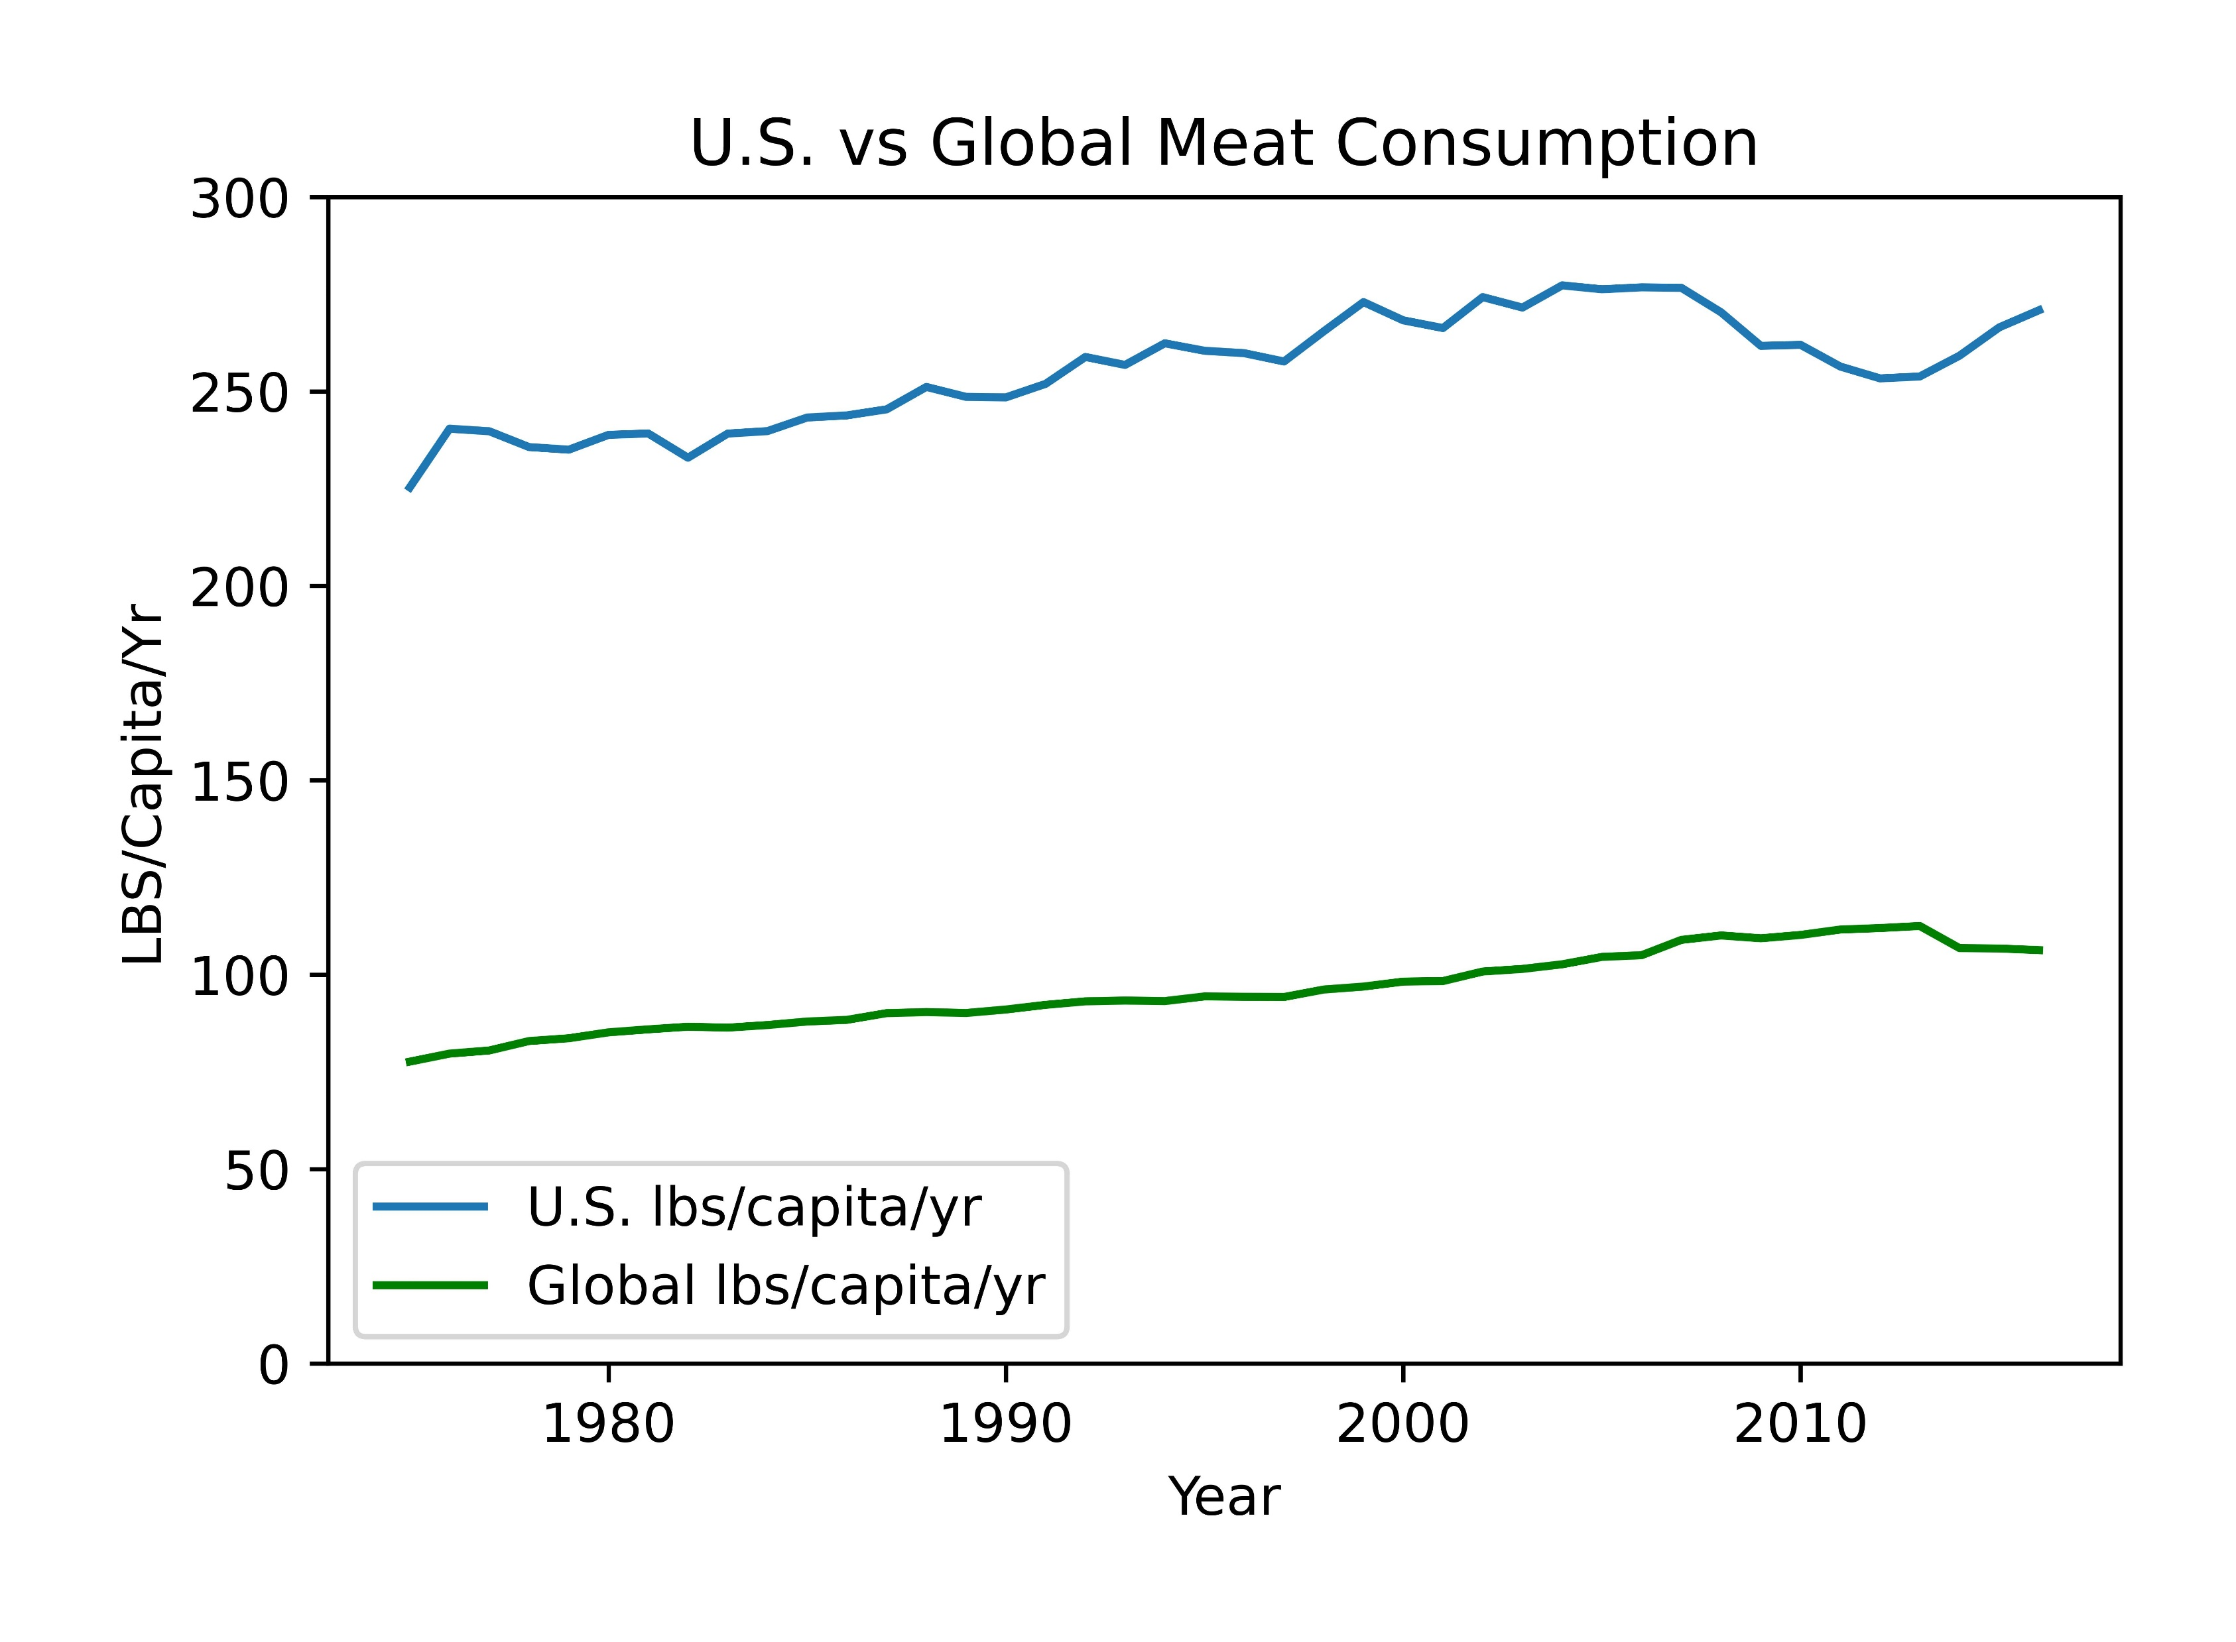
Notes:
This slide compares the U.S vs Global meat consumption as lbs of meat per capita per year. As you can see there is an upward trend over the timeframe with the U.S. having a much larger average that the global average.

Slide 12
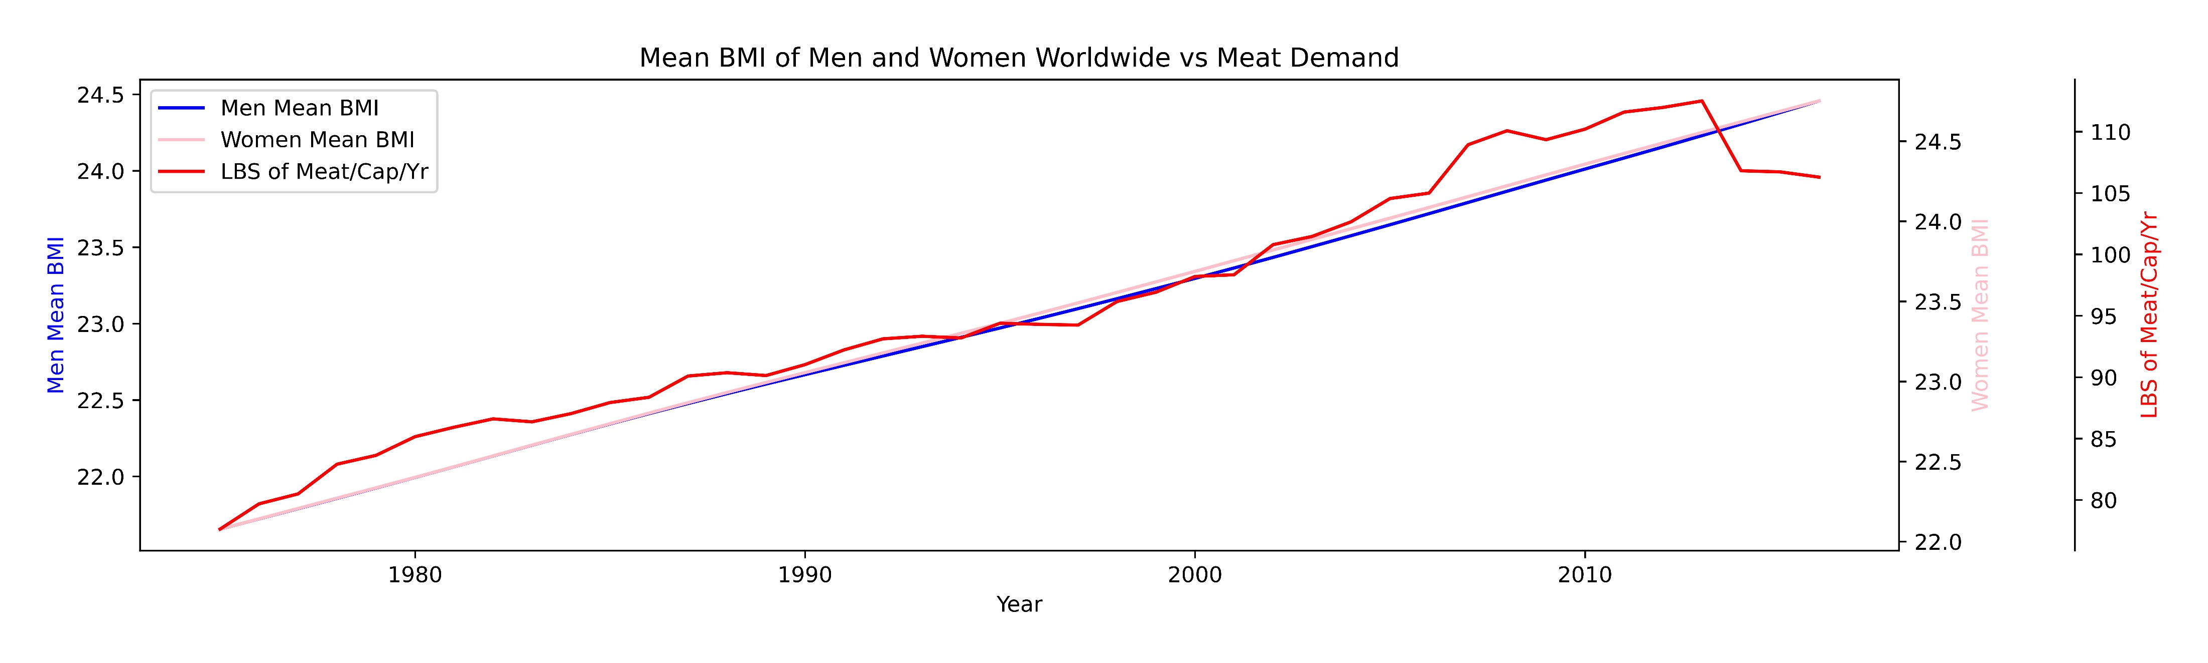

Slide 13
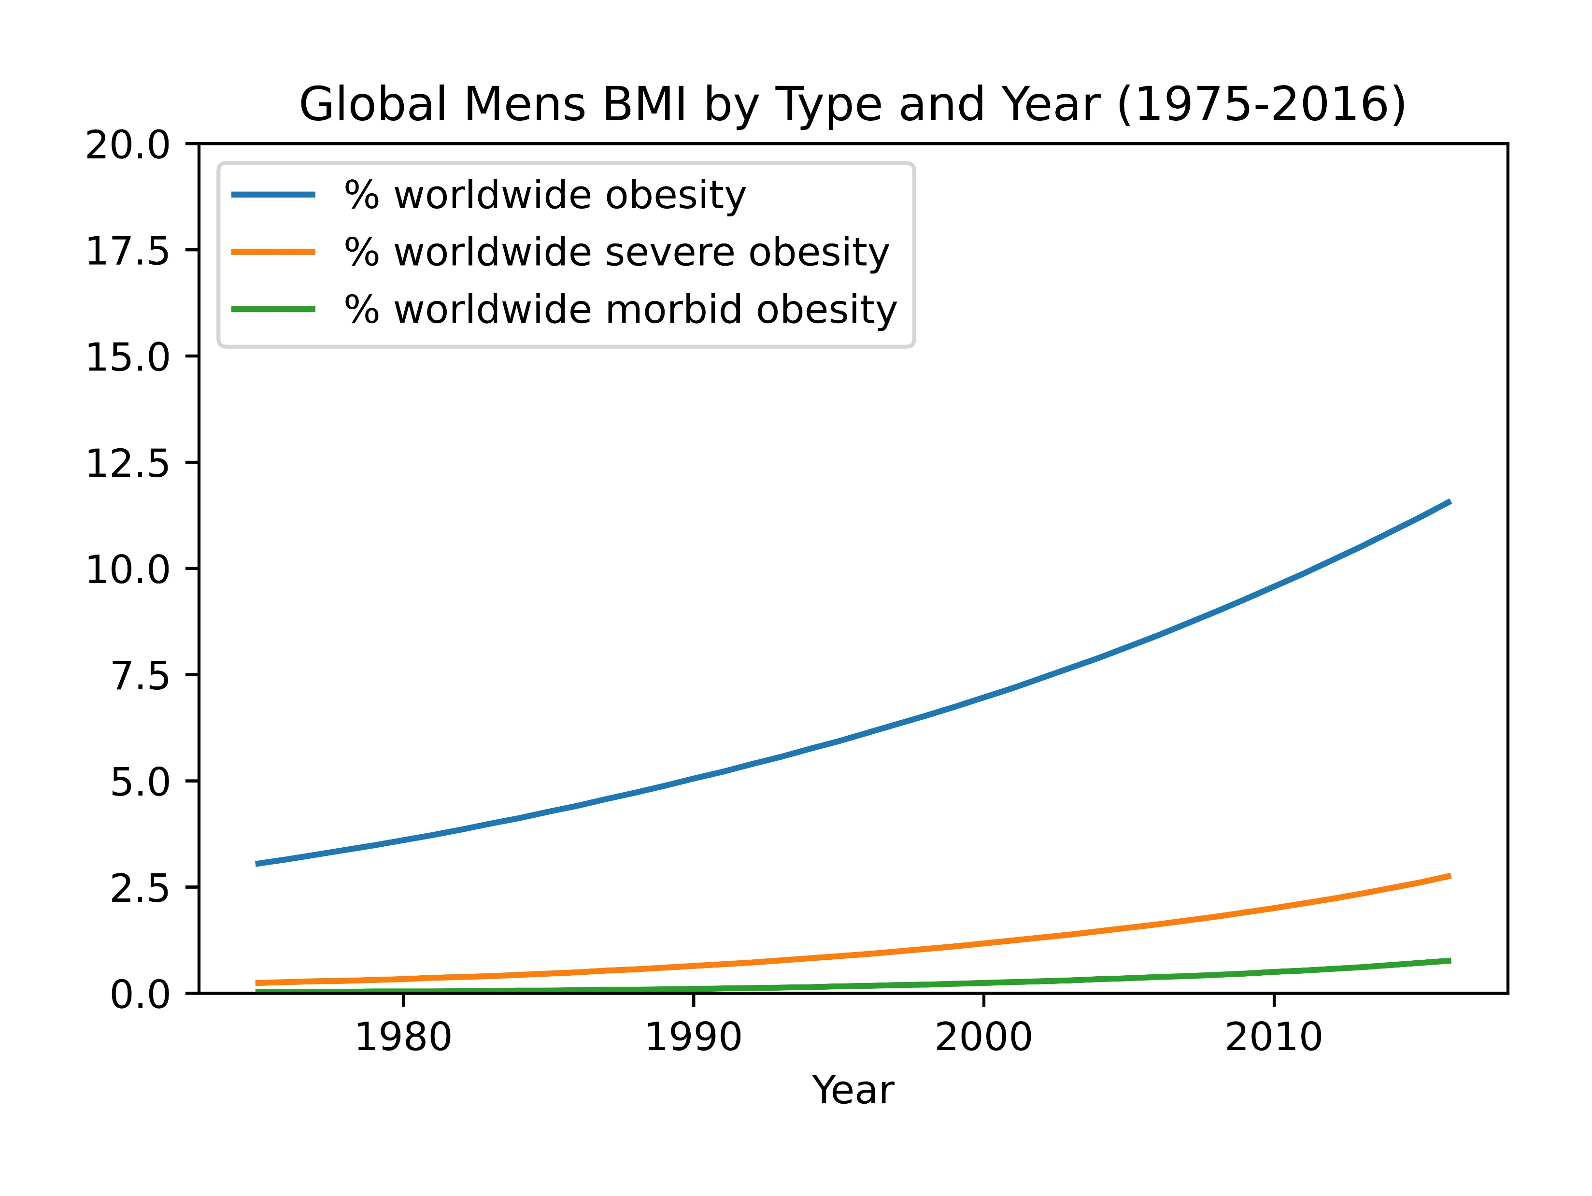
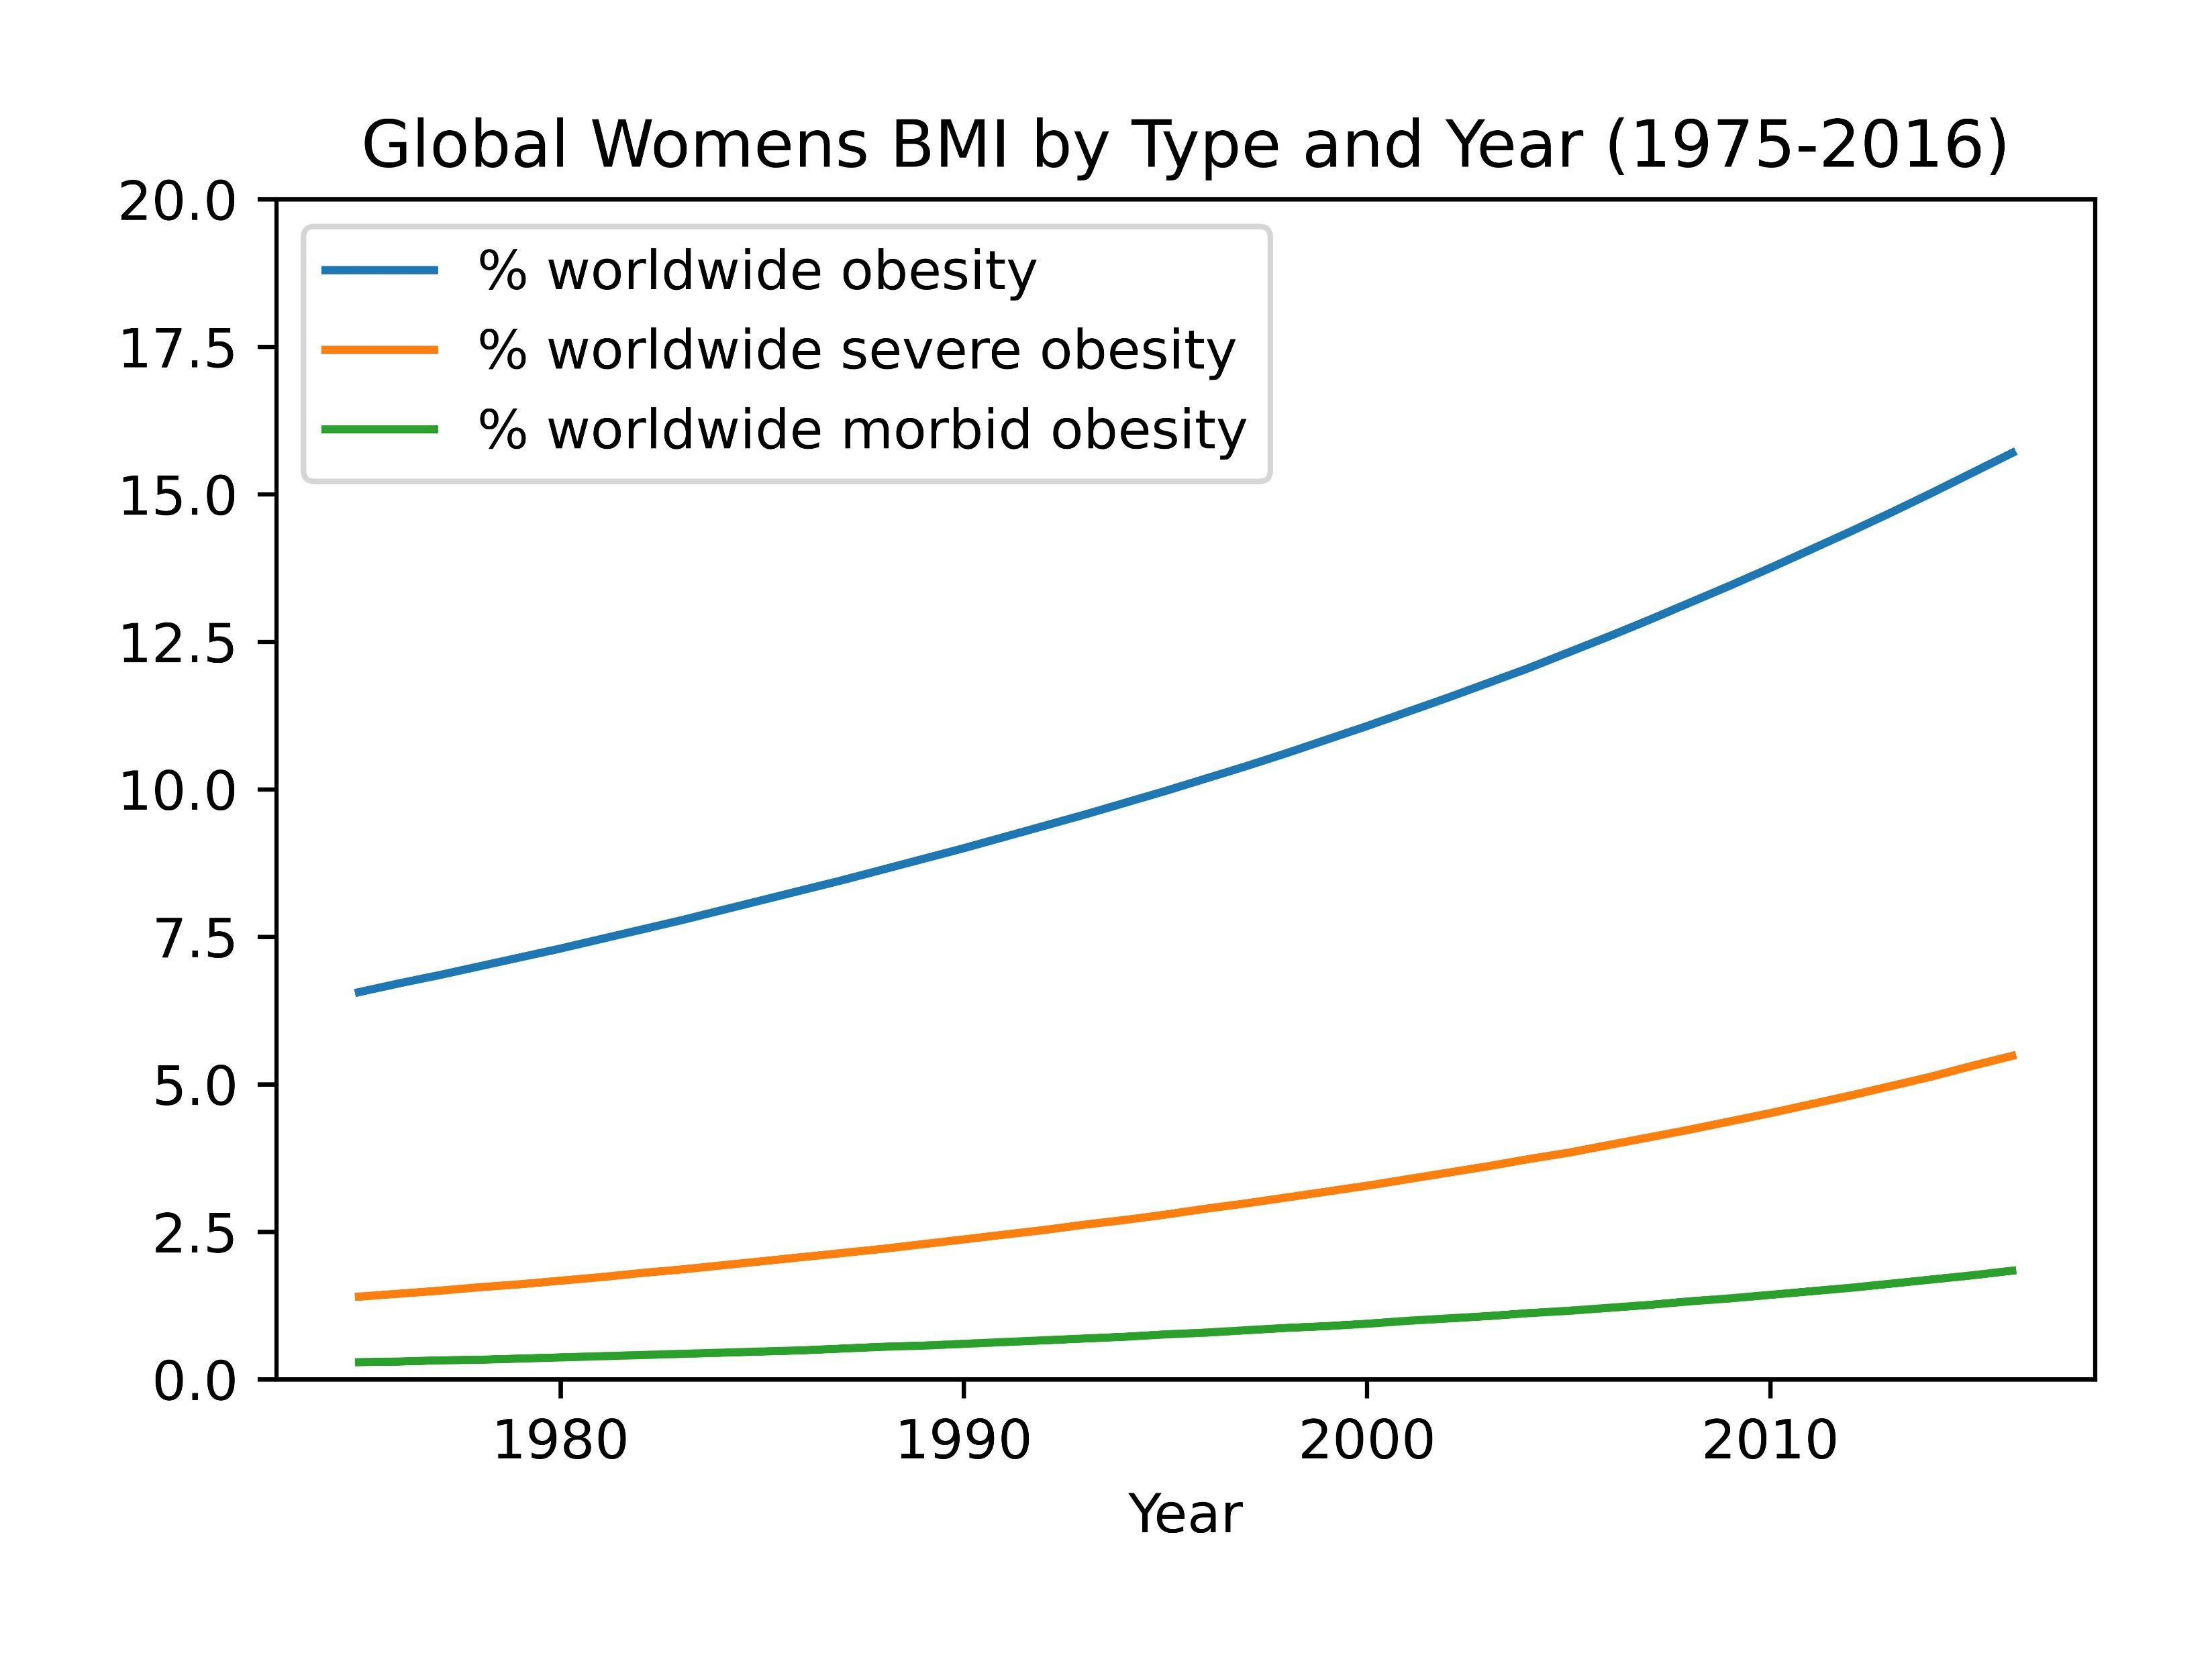
Notes:
And here is the percentage of Individuals worldwide by obesity class type. Again, you can see that the worldwide data shows the percentage having an upward trend with class one obesity having a slightly steeper trend than severe or morbid obesity.

Slide 14
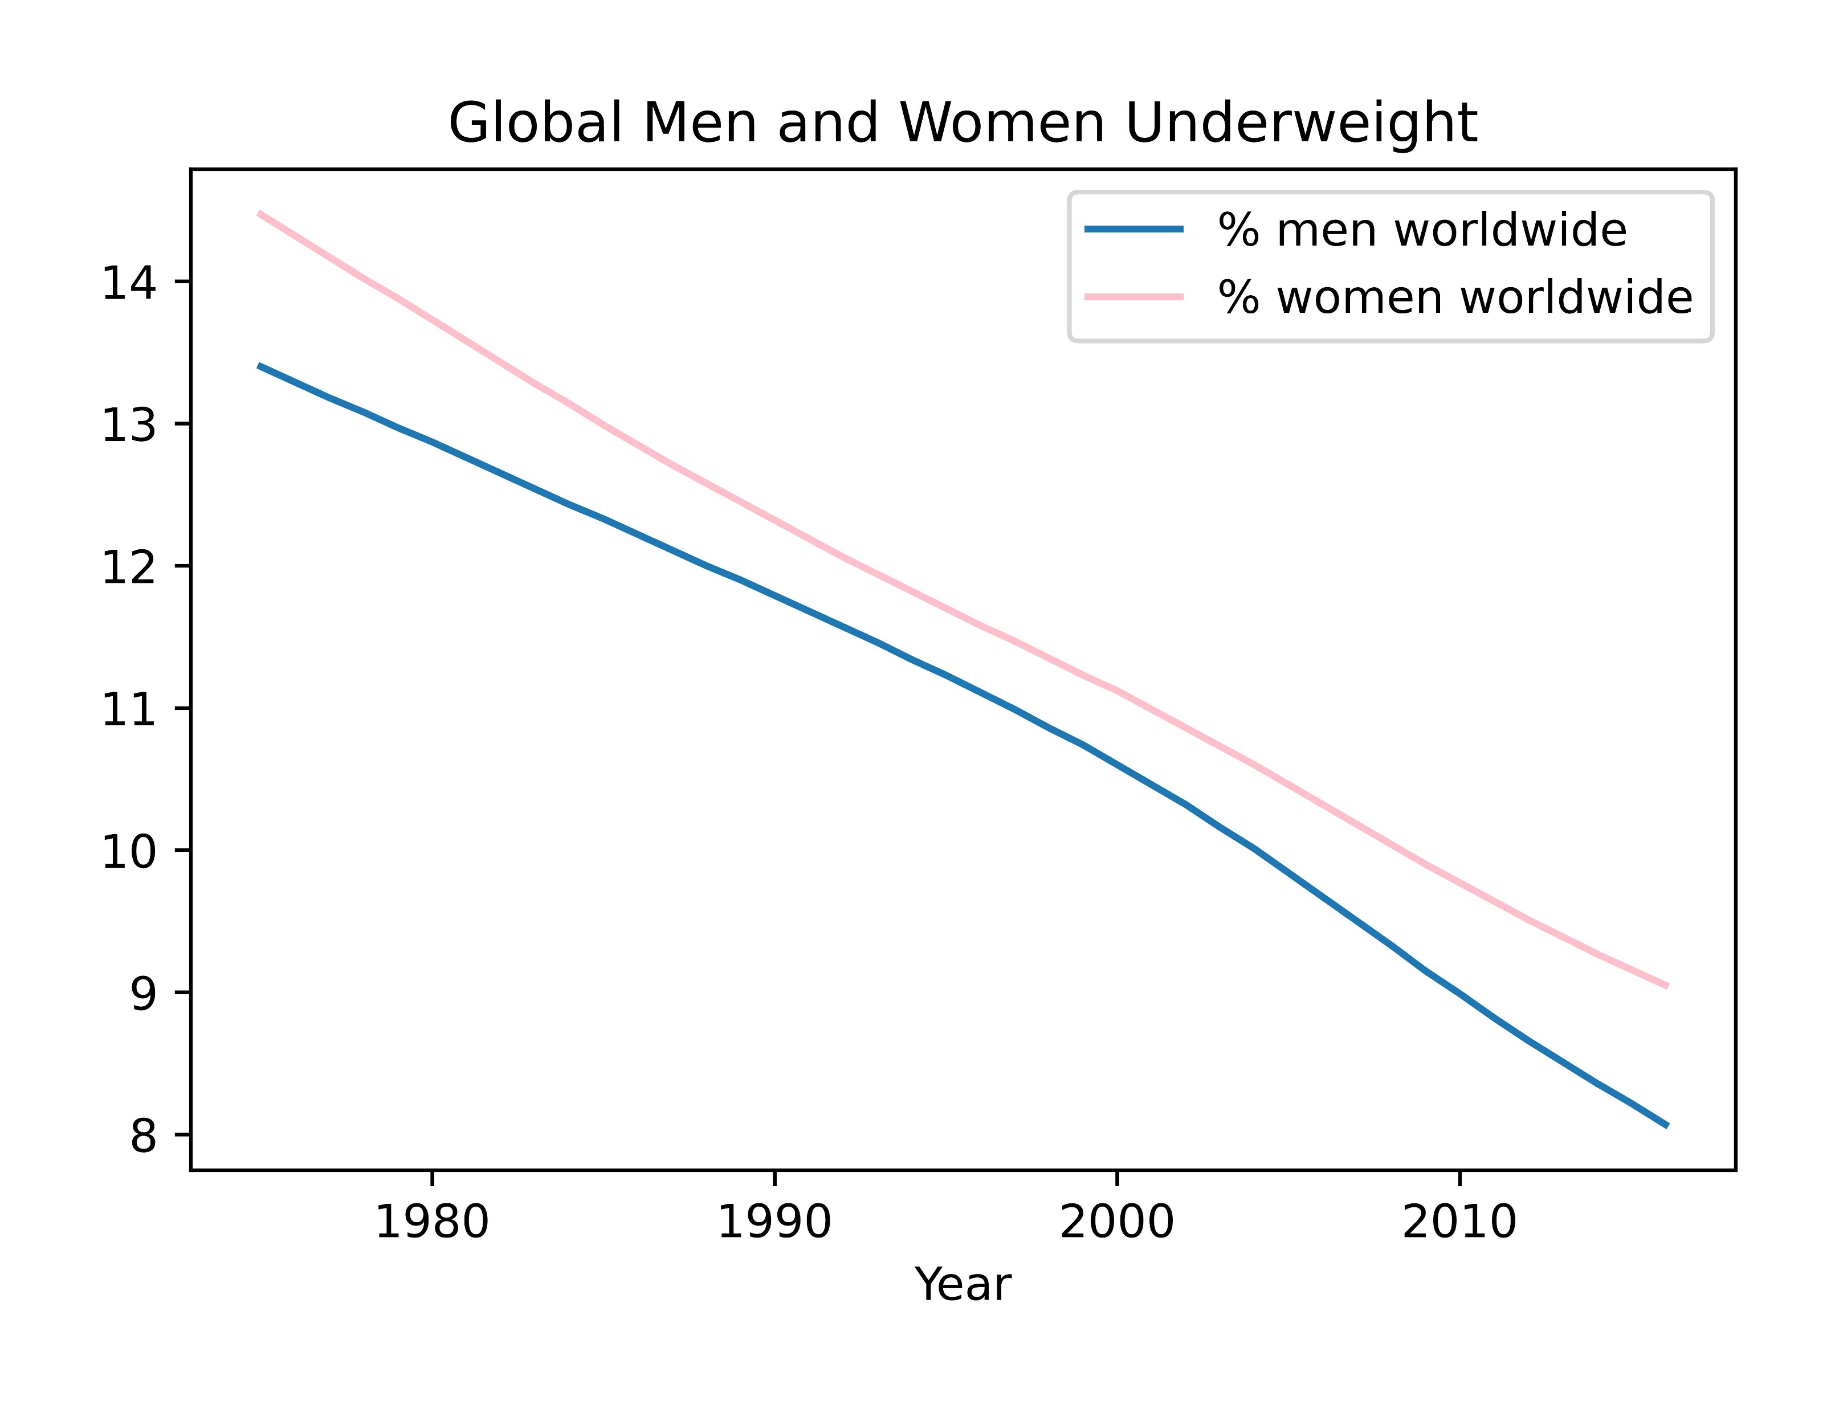
Notes:
And here we show the global percentage of underweight individuals trends downward over the timeframe with both men and women seeming to appear similar.

Slide 15
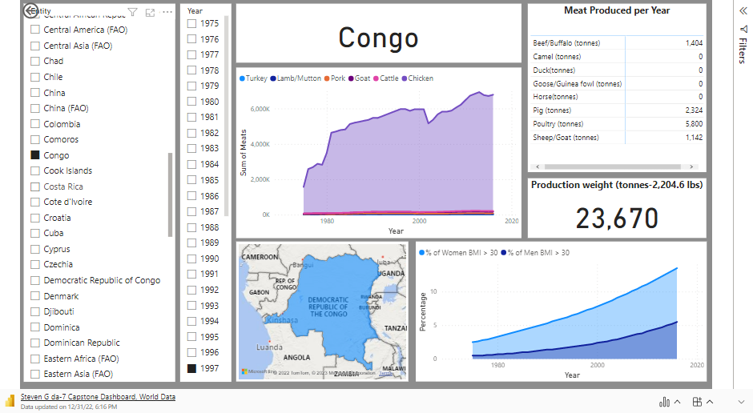
Notes:
This interactive dashboard will allow you to choose any specific country to see the individual meat and production weight by year chosen. This helps to see if there are any outliers or exceptions to the previous findings.

Slide 16
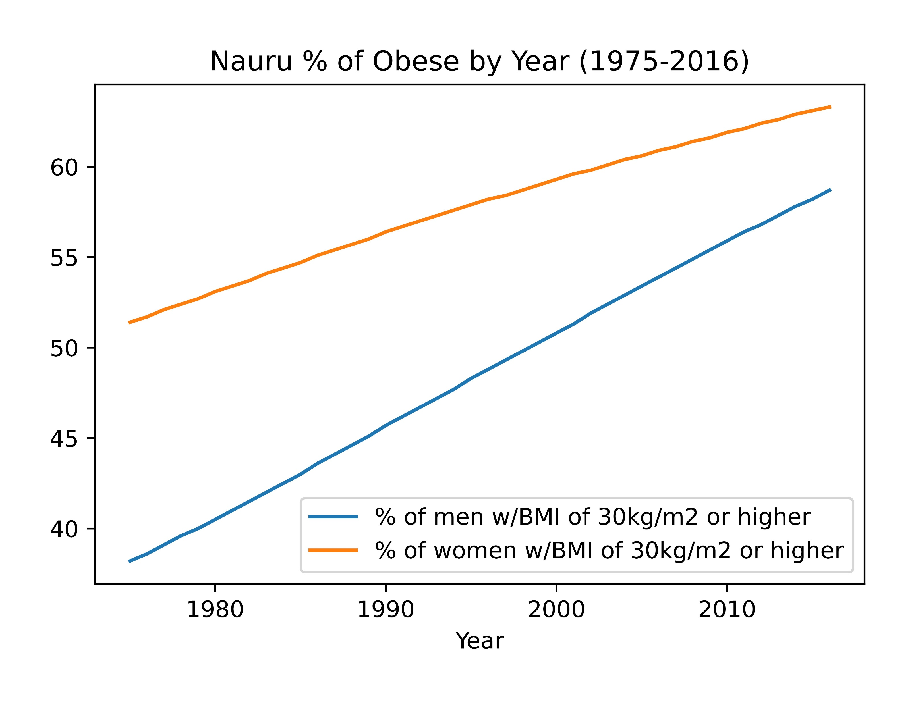
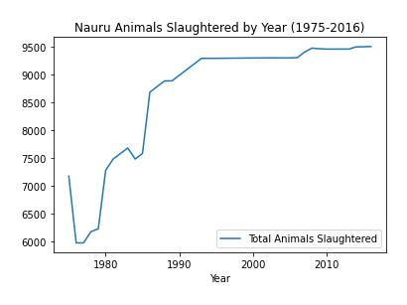
Outliers or Exceptions Example:
Notes:
Of course there will be some outliers or exceptions to the data. Here is one case that stood out to me. The country of Nauru actually has the highest BMI rate worldwide. As you can see the percentage of individuals with a BMI of 30kg/m2 or higher is extremely high but the animals slaughtered for consumption is actually very low.

Slide 17
Conclusions
There definitely appears to be a similar trend in meat consumption and obesity rates.
There does not appear to be a significant difference, positive or negative, between the rates in men and women.
While these findings appear to show a possible link between consuming meat and obesity, there are many factors that are not included in this report.

Slide 18
Thank You!!
Notes:
Questions?

